Slide 1




Comunidad práctica de Laboratorios
30 June 2022
Realizing co-creation of public services: INTERLINK
Diego López-de-Ipiña (Univ. Deusto)
dipina@deusto.es
@dipina

Slide 2

Towards more citizen-centric and sustainable public services
The INTERLINK H2020 project aims to overcome the barriers that hinder administrations to reuse and share services with private partners (including citizens) by combining the advantages of two often opposed approaches:
  “top-down” approach where Government holds primary responsibility for creating these services compliant with EU directives, sometimes seeking the support of citizens for specific design or delivery tasks
  “bottom-up” approach in which citizens self-organize and deliver grassroot services where government plays no active role in day-to-day activities but may provide a facilitating framework

Slide 3
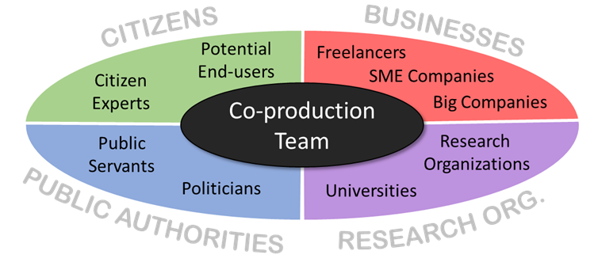
Teaming up co-producers: quadruple helix

Slide 4
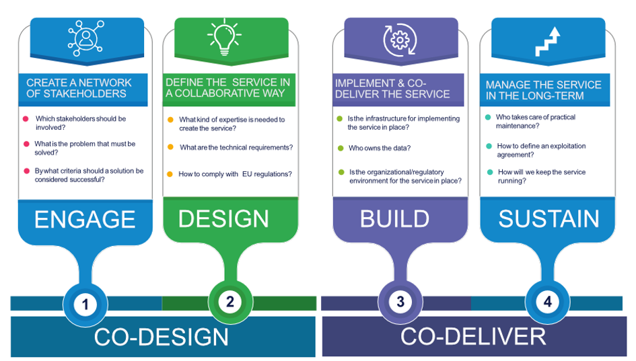
INTERLINK co-production methodology

Slide 5
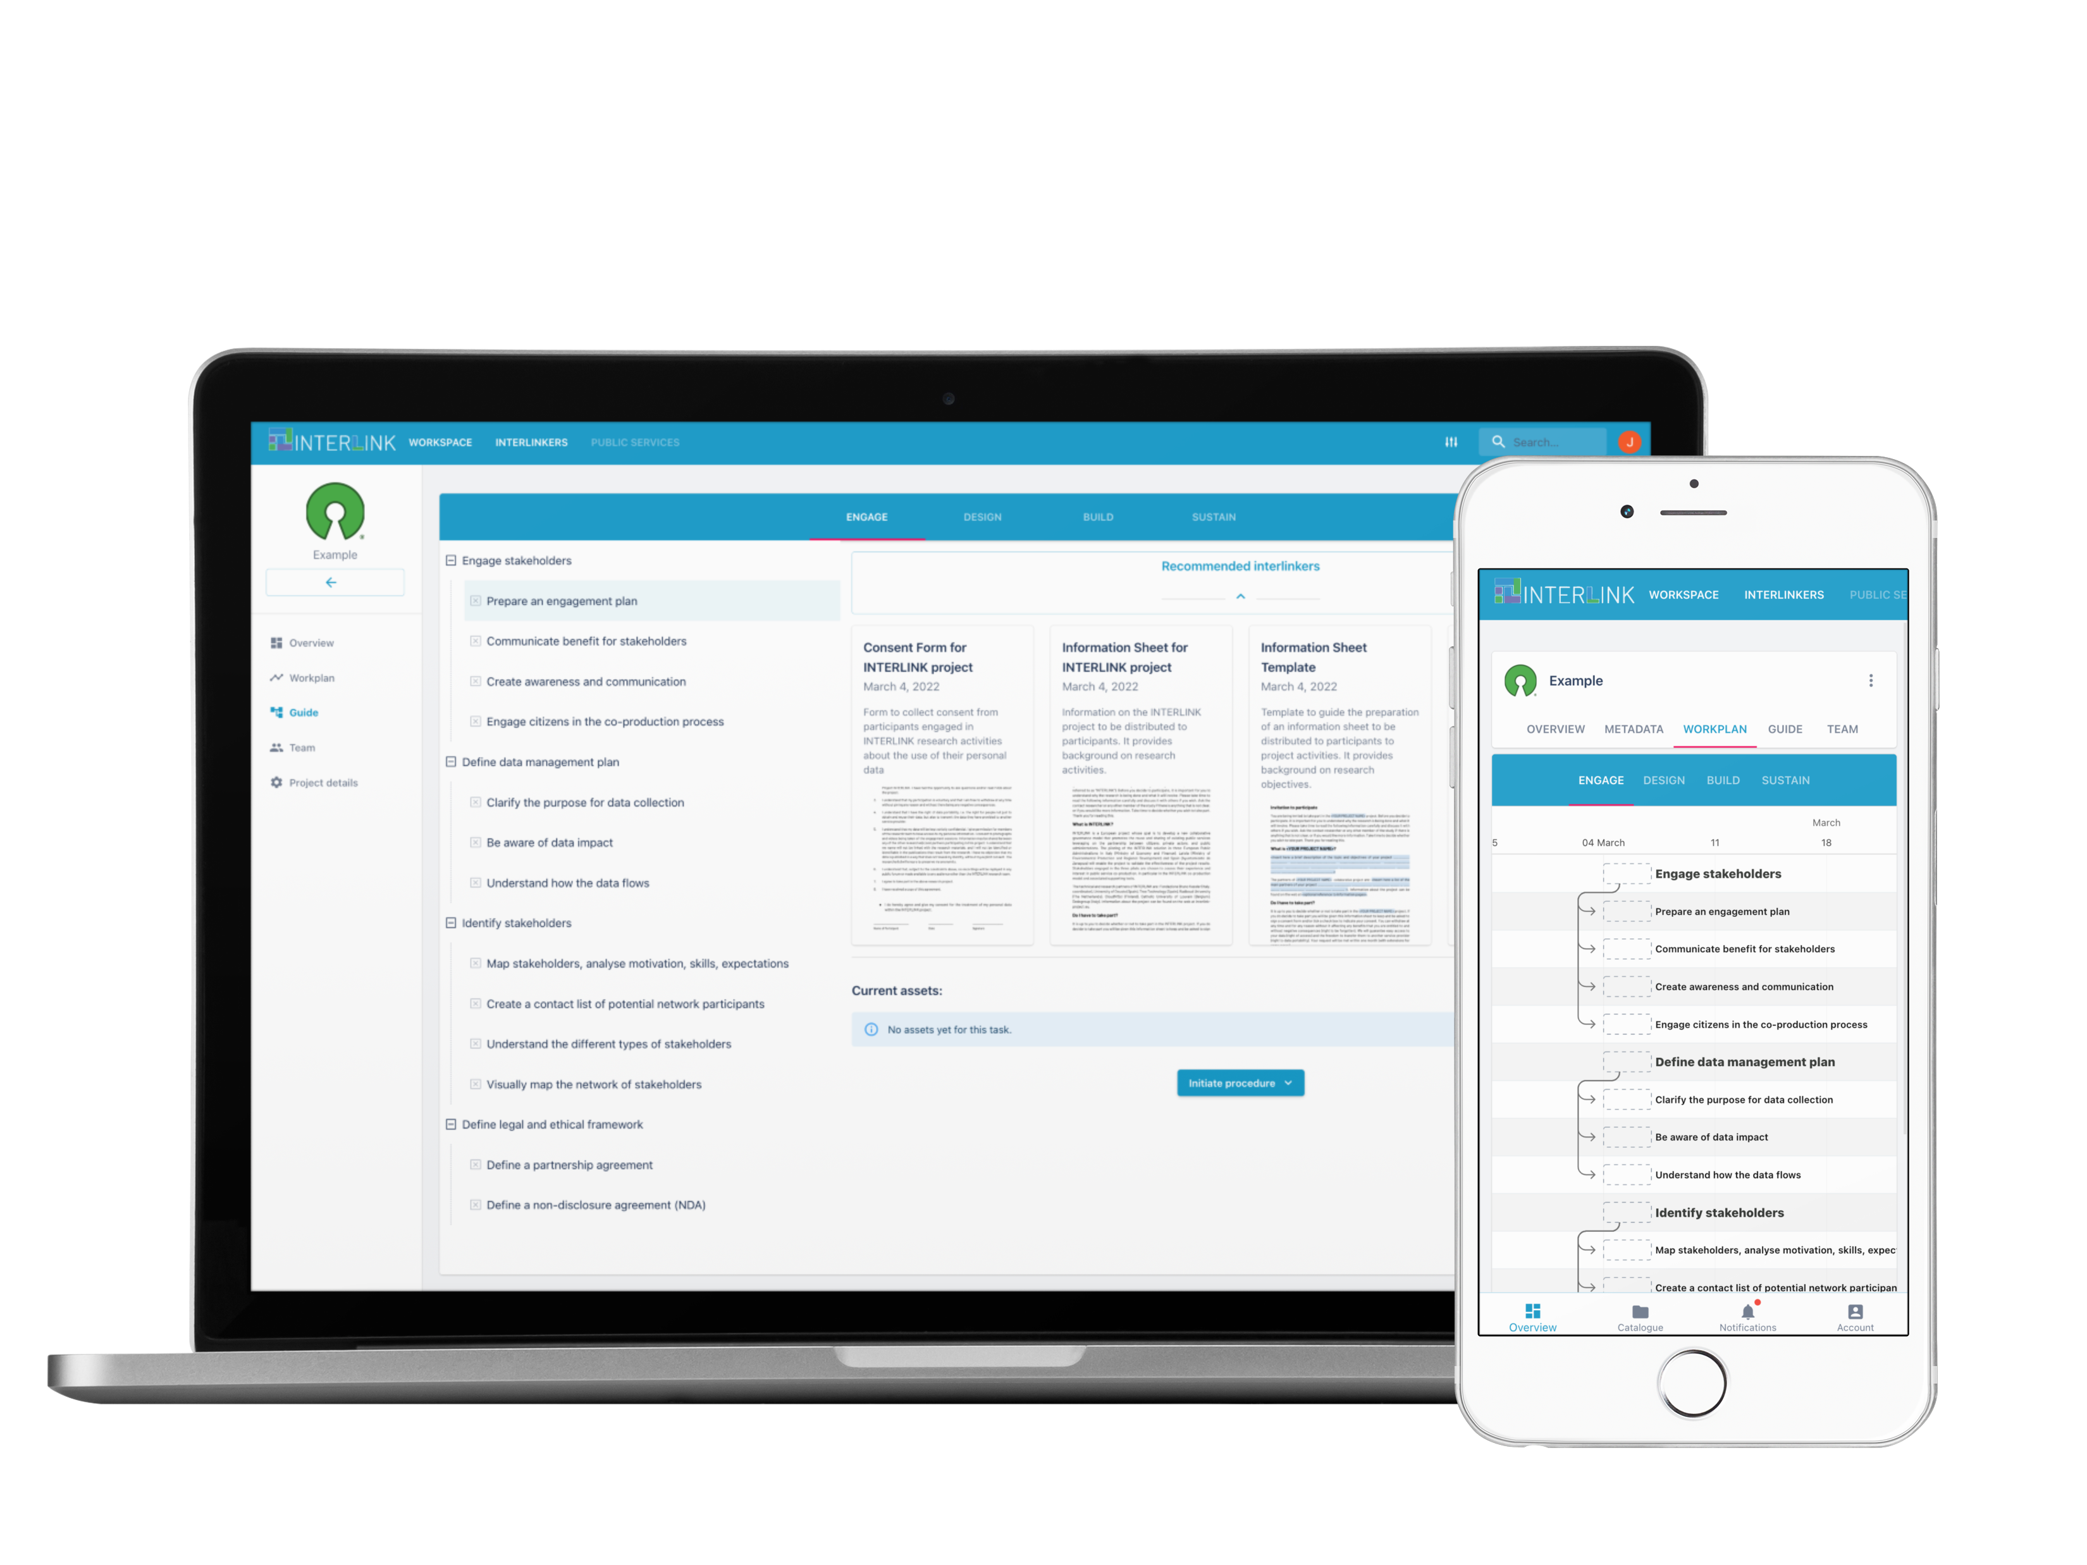
INTERLINK’s key principles and concepts
COLLABORATION & RE-USE
  The INTERLINK platform offers a digital environment that facilitates co-production processes between Public Administrations, private stakeholders and citizens and promotes the re-use of software for delivery of public services.
CO-DESIGN & CO-DELIVERY
  INTERLINK provides a step-by-step guidance for the co-production and co-delivery of public services along with guidelines, tips and templates that facilitate the collaboration of different actors.
INTERLINKERs
  Pieces of knowledge or software that your team can re-use and customize to deliver services.

Slide 6
INTERLINK Collaborative Environment
Designed to support the co-production methodology of INTERLINK and facilitate its adoption and application in the co-production of novel public services
It offers the following core functionalities:
  Co-producer team and project management;
  Guide for co-production process;
  Recommendation of INTERLINKERs most suitable to the problem profiles represented by the chosen co-production task;
  Selection and registry of use (displaying result of using the enabler, e.g. instantiation of a Business Plan) and
  Access to INTERLINKER catalogue
Designed to maximize extensibility, adaptation and reusability by making use of declarative models for INTERLINKERs and co-production schemas

Slide 7
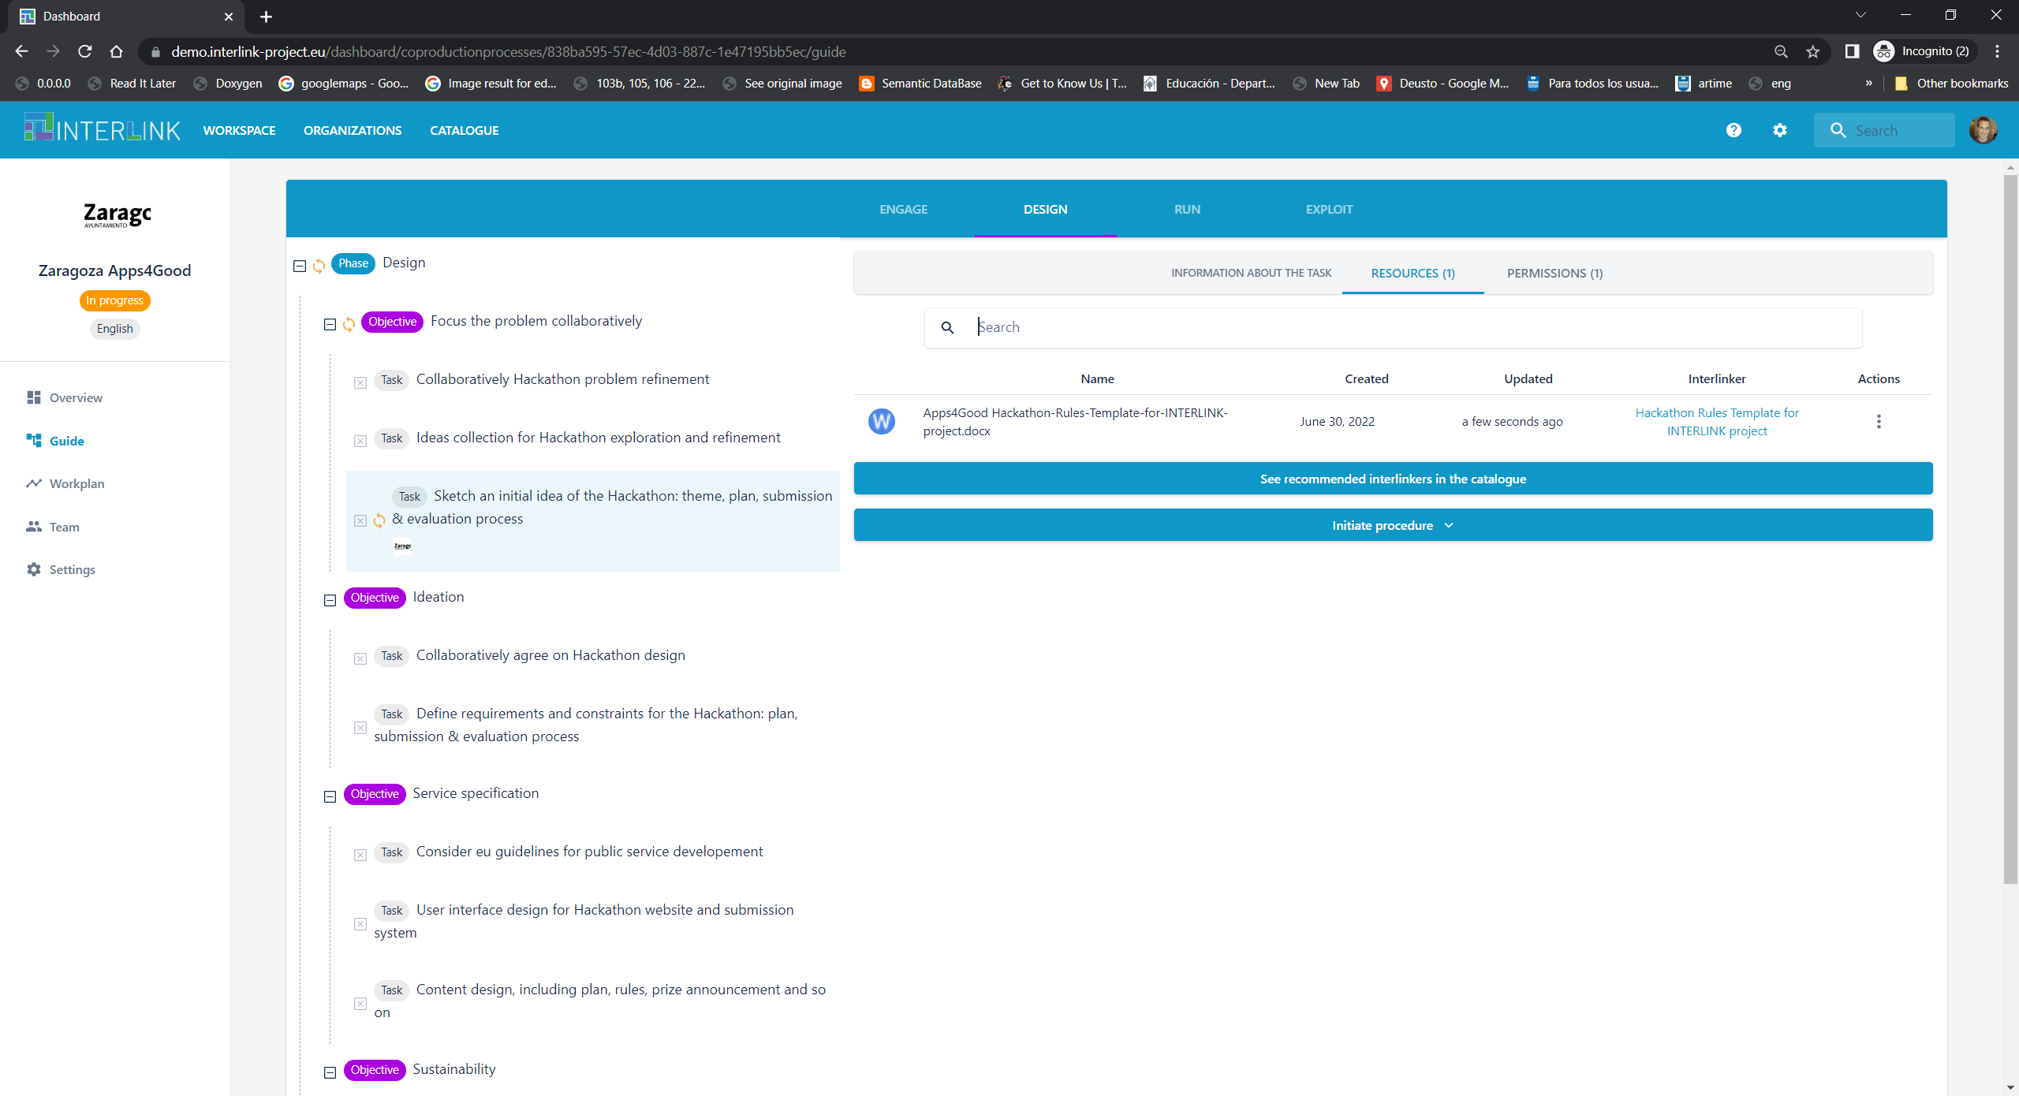
Collaborative Environment

Slide 8
Demonstrating co-creation
Let’s consider the co-production of Hackathon for Good
We would create a new co-production process “Zaragoza Apps4Good”
Create a new team within Zaragoza organization “ZGZ Apps4Good Hackathon organizers”
Select a suitable co-production tree for such co-creation artefact (“#2 Hackathon creation process”)
Be guided by the co-production tree to make progress in the process
  Create rules (DESIGN\Focus the problem collaboratively\Sketch an initial idea of the Hackathon: theme, plan, submission & evaluation process)
    Only organizers can modify it
  Create participation form (RUN\Service Implementation\Open Submissions)
    Participants can only view it
You may involve different users to see different aspects (hackathon organizers & participants)

Slide 9
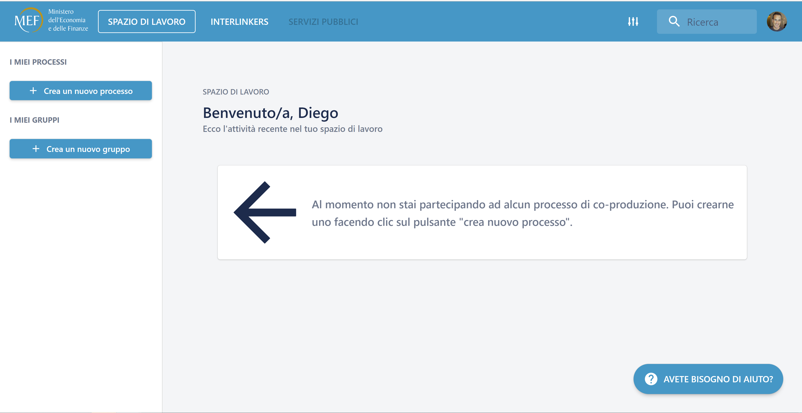
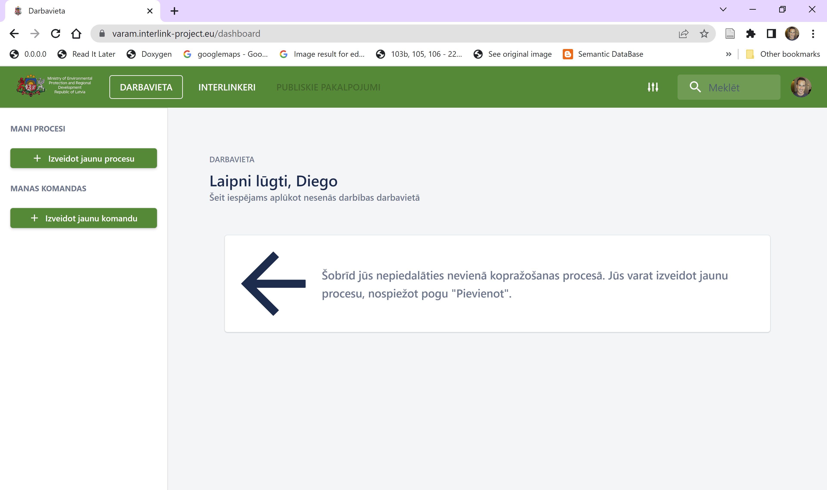
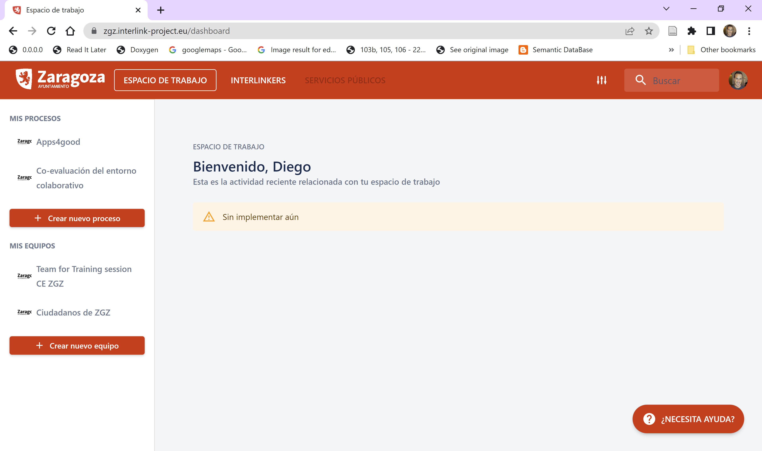
Deployment Environments
We can find them at the following URLs:
  https://mef.interlink-project.eu/
  https://varam.interlink-project.eu/
  https://zgz.interlink-project.eu/

Slide 10
Pilots’ planning: approach
    2 iterations per pilot:
    2 sub-phases per phase:

Slide 11
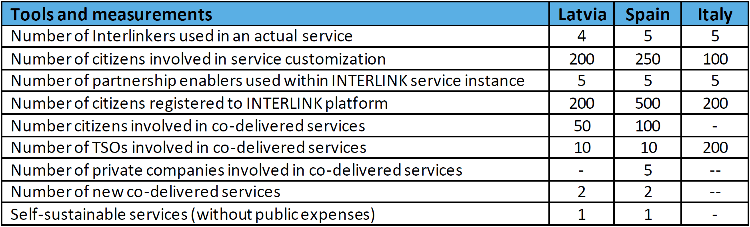

Evaluation goals
Global or pilot-agnostic goals:
  INTERLINK USE and CO-PRODUCTION of SERVICES. The number of INTERLINKERs in use, stakeholders involved with the INTERLINK solution during the two Pilots, as well as the co-production of services enabled by INTERLINK, which correspond to the KPIs specified in the Proposal and their targets
  THE VALUE PROVIDED by INTERLINK. The value improvements provided by the INTERLINK solution
  THE USERS’ PERCEPTIONS of INTERLINK. Users’ perceptions of INTERLINK regarding acceptance, usability, and trust
Local or pilot-specific goals:
  PILOT SPECIFIC KPIs. Custom made at each pilot site
Notes:
INTERLINK decreases the PA’s administrative and management costs;
INTERLINK increases the number and quality of co-produced initiatives;
INTERLINK increases the participation of citizens and private entities in the customization and co-delivery of services.

Slide 12
Evaluation dimensions & constructs
INTERLINK pilots aim to assess whether the co-production model & supporting tools and co-produced assets put forward by the project will enhance the quality, quantity, and reuse of public services among European public administrations (PAs).
  What will be the degree of ADOPTION achieved by INTERLINK co-production model, supporting tools and co-produced public services and INTERLINKERs?
Notes:
Product quality: based on ISO/IEC 25010:2011 [16] quality model, it indicates the degree to which a particular service or product conforms to its specification
User-based quality: based again on ISO/IEC 25010:2011 [16] quality model, it means that the attributes of a product meet the customer’s requirements
Value-based quality: quality as services being in line with requirements of public services (e.g. legal treatment) and broader societal notions (e.g. democratic values).
We propose to measure quality through three dimensions, as shown in Figure 24:
Product quality: based on ISO/IEC 25010:2011 [16] quality model, it indicates the degree to which a particular service or product conforms to its specification. The quality model determines which quality characteristics will be taken into account when evaluating the properties of a computer system or software product. The quality of a system is the degree to which the system satisfies the stated and implied needs of its various stakeholders, and thus provides value. Those stakeholders' needs (functionality, performance, security, maintainability, etc.) are precisely what is represented in the quality model, which categorizes the product quality into characteristics and sub-characteristics. The product quality model defined in ISO/IEC 25010 [17] comprises the eight quality characteristics shown in Figure 25.
Figure 25. Product quality characteristics of ISO/IEC 25010.
User-based quality: based again on ISO/IEC 25010:2011 [16] quality model, it means that the attributes of a product meet the customer’s requirements (in the public sector this is very important due to the need for public accountability). The “quality in use” model is composed of five characteristics as shown in Table 34 (some of which are further subdivided into sub characteristics) that relate to the outcome of interaction when a product is used in a particular context of use.
Effectiveness: accuracy and completeness with which users achieve specified goals
Efficiency: resources expended in relation to the accuracy and completeness with which users achieve goals
Satisfaction: degree to which user needs are satisfied when a product or system is used in a specified context of use
Freedom from risk: degree to which a product or system mitigates the potential risk to economic status, human life, health, or the environment
Context coverage: degree to which a product or system can be used with effectiveness, efficiency, freedom from risk and satisfaction in both specified contexts of use and in contexts beyond those initially explicitly identified
This system model is applicable to the complete human-computer system, including both computer systems in use and software products in use. Note that Usability is defined as a subset of quality in use consisting of effectiveness, efficiency, and satisfaction. Usability can either be specified or measured as a product quality characteristic in terms of its sub-characteristics or specified or measured directly by measures that are a subset of quality in use. Besides, we have integrated quality in use from ISO/IEC 25010:2011 [16] with SERVQUAL[18], an approach for measuring customers’ subjective assessment of service quality. Through a survey, as this example [19], you ask your customers to rate the delivered service compared to their expectations. Its questions cover what SERVQUAL claims are the five elements of service quality, termed by the acronym RATER. These five SERVQUAL dimensions are used to measure the gap between customers’ expectations for excellence and their perception of the actual service delivered. The SERVQUAL instrument, when applied over time, can help you understand both customer expectations, perceptions of specific services, and areas of needed quality improvements:
Reliability. The ability to deliver the promised service in a consistent and accurate manner.
Assurance. The knowledge level and politeness of the public service stakeholders and to what extent they create trust and confidence.
Tangibles. The appearance of e.g. the building, website, equipment and employees.
Empathy. To what extent the employees care and give individual attention.
Responsiveness. How willing the employees are to offer a speedy service.
Value-based quality: quality as services being in line with requirements of public services (e.g. legal treatment) and broader societal notions (e.g. democratic values). The following quality characteristics will be considered:
Democracy: citizens’ perception that e-government systems empower the public.
Inclusiveness refers to citizens’ perception that the e-government system increases the accessibility of public services and makes service delivery more egalitarian.
Autonomy: The autonomy of consumers, e.g. to control the use of data might be a further important point in contrast to dependency and subordination (it is thus linked to enabling citizens)
Perceived privacy protection effect on customer satisfaction: Perceived privacy protection is a critical element in evaluating online and offline services.
Public service relevant Weberian principles:
Impartiality/Neutrality
Rule-boundedness
Scribability (existence of “files”)
Professionalism
Table 34. Quality in use characteristics and sub characteristics, explained at [16].
Effectiveness
Efficiency
Satisfaction
Usefulness
Trust
Pleasure
Comfort
Freedom from risk
Economic risk mitigation
Health and safety risk mitigation
Environmental risk mitigation
Context coverage
Context completeness
Flexibility
Notice that our hypothesis is that combining product-, user- and value-based quality allows a comprehensive account of the quality associated to the co-production process and the resulting e-government artefacts. This may lead to higher trust on co-produced public services, which may enhance acceptance and, hence, ultimately, aid the adoption of co-production results among PA stakeholders. Notice that trust (in technology/government/e-government) is necessary for citizens to participate and at the same time, participation may lead to enhanced levels of trust (in e-government services).

Slide 13
Qualitative and quantitative measures for evaluation gathered at each pilot
Logging mechanism for understanding user-behaviour in co-production and as end users
  Guiding document and spreadsheet
Questionnaires for alpha testers (alpha scripts, activity satisfaction, UEQ and in-app questionnaires)
Questionnaires for beta testers (for co-producers and end-users)
KPIs tables: pilot wide and specific metrics
Cognitive Walkthrough, Heuristic Evaluation, Think-Aloud, In-depth interviews or videos, and other techniques
Pilot Execution sub-phase
Data logs
Cognitive walkthrough
Heuristic evaluation
Alpha questionnaires
Data logs
In-app questionnaires
Online surveys
Think-aloud methods
Interviews
April (M16)-May (M17) 2022
June (M18)-September (M21) 2022
Notes:
Cognitive Walkthrough
Who: new user
What: performs list of specific tasks
Why: to see if the tasks can be performed in the correct sequence of actions they were designed in
Heuristic Evaluation
Who: system specialist (preferably)
What: examines if the system in question abides by recognized usability principles
Why: to see if the system can comfortably be used based on prior experience in similar systems
Usability Testing
Who: end-user
What: uses the system for its intended purpose, as if he/she would be in a realistic situation at home/work/etc.
Why: to give direct input on how real users use the system

Slide 14


Use case: goal and iterations
MEF’s use case goal is to leverage on the INTERLINK platform and its enablers to co-design a Participatory Strategic Planning Module (PSPM). These goals are divided into two clear phases of co-design.
Use Case Structure
First Iteration:
CO-DESIGN PHASE
Second Iteration:
CO-CREATION PHASE
The first iteration has the goal of collecting expectations, requirements and feedback from stakeholders in order to test the usability of the INTERLINK platform and to co-design a blueprint of the PSPM (Participatory Strategic Planning Module) open to Public Bodies to allow their participation in the definition of the MEF’s Strategic Plan.
The second iteration, foresees further work on the INTERLINK platform, its enablers, and the PSPM alongside some of the same and potentially new stakeholders to gather additional requirements and feedback. The result of these interactions will be a mock-up of the PSPM.
Between iterations
a blueprint of the PSPM
will be produced
17/06/2022

Slide 15
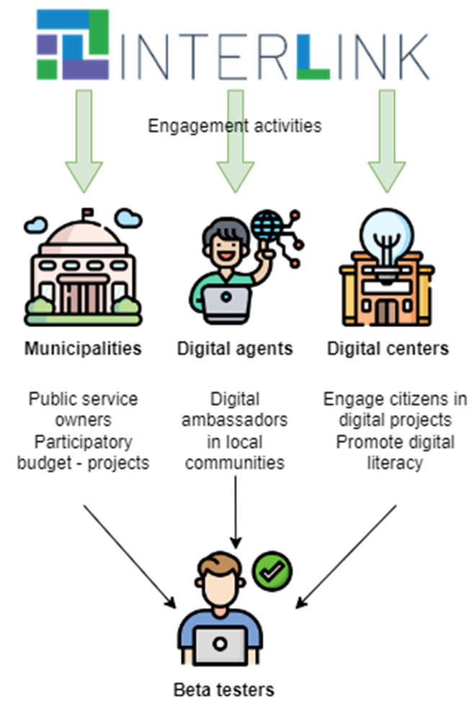

VARAM use-case goal
VARAM aims to improve public services, by involving a wider range of stakeholders in the development and provision of public (specifically municipal) services.
The focus of VARAM pilot is unified municipal services that are provided by all or majority of Latvian municipalities.

Slide 16
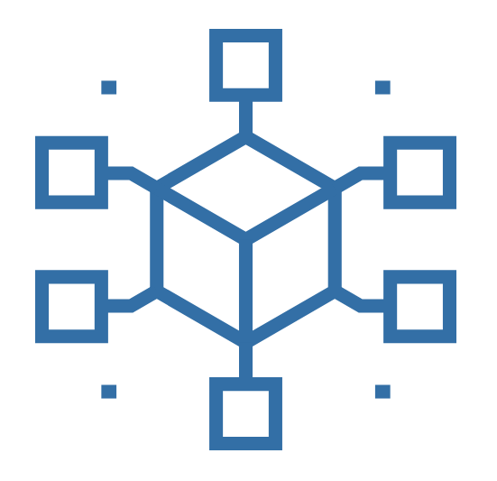

Zaragoza UC context
eTOPIA_ Center for Arts & Tech. Municipal Innovation Hub
Public admin
The City of Zaragoza (ZGZ) together with Zaragoza City of Knowledge Foundation (FZCC) work jointly to promote collaborative and innovative programs in education, entrepreneurship, smart city, and digital culture.
Etopia. Center of art and technology, is the headquarters of both the Smart City Service and the Zaragoza City of Knowledge Foundation.
In addition to Zaragoza City Council's Smart City Service and the Zaragoza City of Knowledge Foundation, Etopia also involves other stakeholders who design, organise and produce different programmes aimed at schools, creators, artists, researchers, entrepreneurs, companies and citizens in general.
NGOs
Civic Tissue
Research
Artists
Entrepreneurs
17/06/2022
DG.O 2022: Democratizing co-creation

Slide 17
Zaragoza UC: Goals and Expectations
Provide a digital layer to our physical co-creation and co-delivery activities
Increase our internal productivity through better reporting, tracking, and booking, also creating a data feedback loop for agile improvement
Improve the citizen perception in our brand as a City Making Center through a more accessible and open catalogue of services
Promote the transition from users to co-producers and co-deliverers from an agile and "open source" approach.
Enhance the engagement and participation level of the communities around Etopia_ including its co-governance through tokenization and gamification.

Slide 18
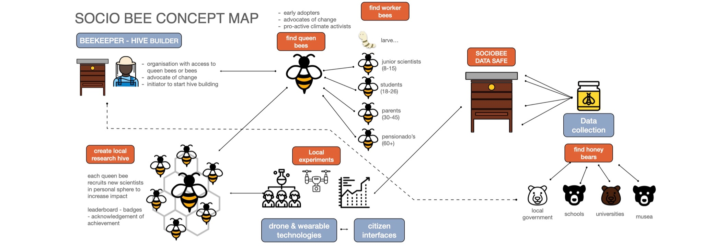
Otras iniciativas: SOCIO-BEE & GREENGAGE

Slide 19


https://interlink-project.eu/

